Slide 1
App Update Review Project
Stephon Mensah

Slide 2


Motivation
Instagram, with billions of users worldwide, undergoes frequent updates. I want to evaluate how often the main concerns of users truly addressed through updates?
Understanding user feedback and integrating it into app updates can significantly enhance user satisfaction and retention.

Slide 3
Project Statement
Are the Instagram development team integrating user feedback from reviews into new app versions?
Aiming to analyze Instagram user reviews and match them against the app's update change-logs to determine the alignment.

Slide 4
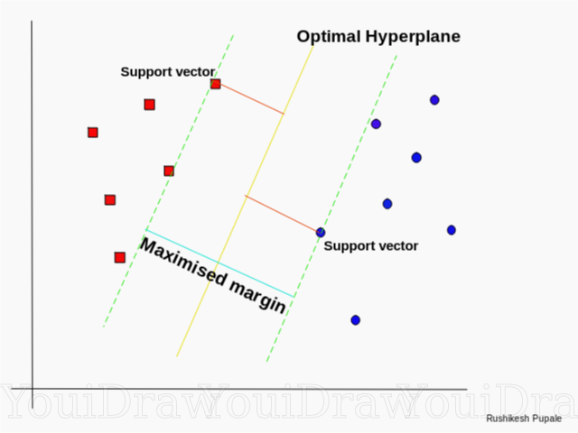
Proposed Work
Data Collection: Extract Instagram user reviews and change-logs across various versions manually, using web scraping tools or available APIs.
Data Preprocessing: Before SVM can be applied, the data will need to be preprocessed
Named Entity Recognition (NER): Extract specific features or issues from user reviews and change-logs.
Support Vector Machine (SVM) Analysis: Employ SVM, with a suitable kernel method, to classify change-logs based on user reviews. Depending on initial outcomes, we might experiment with different kernel functions (linear, RBF, polynomial) to better capture the relationships in the data.

Slide 5
Evaluation Plan
Evaluation Metrics:
Alignment Score: Determine how many issues or features mentioned in reviews have corresponding mentions in subsequent change-logs.
User Satisfaction Post Update: Analyze the message of the reviews after the update to gauge if user sentiment improved, confirming that the updates addressed concerns.
Comparison with Past Versions:
Analyze past versions of Instagram to determine if the alignment between user feedback and updates has improved or declined over time.

Slide 6
Feasibility
Week 1(Oct. 17): App selection confirmed as Instagram. Extract user reviews and change-logs. Begin initial preprocessing of data.
Week 2-3(Oct. 31): Ensure data is suitable for SVM. Initiate Named Entity Recognition (NER) to extract key features or issues from user reviews and change-logs.
Week 4-6(Nov. 15): Train the SVM model. Using a linear kernel initially, we'll attempt to classify change-logs based on user reviews. Depending on the nature of our data and initial results, we may experiment with other kernel methods (RBF, polynomial) to capture non-linear relationships.
Week 7-8(Final Presentation): Evaluate SVM results and draw insights. Determine which user feedback was likely addressed in Instagram updates. If time permits, fine-tune SVM parameters or kernel choices for improved accuracy and conclude the analysis.

